Slide 1

NostraDomicile
By:
Ochaun Marshall, Christian Simaan
Jeremy Hutton, Richard Andrews

Slide 2





Slide 3
Approach
Problem:
It can be difficult to determine whether a house will sell and what factors will influence its desirability in a particular area.
Solution:
Create a web application which uses machine learning and determines if a house will sell based on desirable factors in an area and allows users to explore a suite of data visualizations based on their area of interest.

Slide 4
Overview
Approach
Functional Requirements
User-interface Requirements
Security Requirements
System Model
Subsystems
Data I/O
Demonstration
Future Efforts

Slide 5
Functional Requirements
Users able to input attributes and location for predictive home sale analysis
Users able to view data visualizations for housing data based on zip code
Users able to view most influential factors in home sales for a given area
“About” section with detailed explanation of web application functions and its goal.
“Blog” section with articles by experts in real estate.
“Contact” section capable of taking in user feedback via email
“Help” section which offers users a tutorial

Slide 6
User Interface and Usability Requirements
Text area for target zip code in order to return predictions and data visualizations.
Text areas and drop down boxes for users to enter their home’s attributes.
Submit buttons to return prediction on home sale, most important factors for home sales, and data visualizations..
The application will load within 1-2 second interval.
All buttons will conform to the same style.
Any text area, checkbox, or dropdown box will have helpful instructions.
Any function of the web application may be reached within 2-3 clicks.
Any subsequent page within the application will adhere to the same style

Slide 7
System Interface Requirements
Application must be successfully hosted and displayed by cloud service(AWS).
Front end of web application must successfully query database upon user request.
Database must successfully return requested data run through machine learning algorithm, statistical analysis and data visualization program and front end must successfully display request.

Slide 8
Security Requirements
Home data in DB can’t be altered except by authorized automated scripts or administrators.
Realtor blog articles can’t be placed, removed or altered except by administrators.

Slide 9
System Model
Frontend will handle both displaying information to the user, and getting data from the user that will allow our application to analyze attributes.
The backend will analyze the data that the frontend gets, and send it to the machine learning functions/system. The backend will also make request to the zillow api or our database depending on the request made, and whether we have the data required.
We will use the Random Forest Classifier to analyze the data it gets from the backend, and provide answers to the backend.
The database will store information we get from requests to the Zillow API, as well as any other information we need to store.

Slide 10
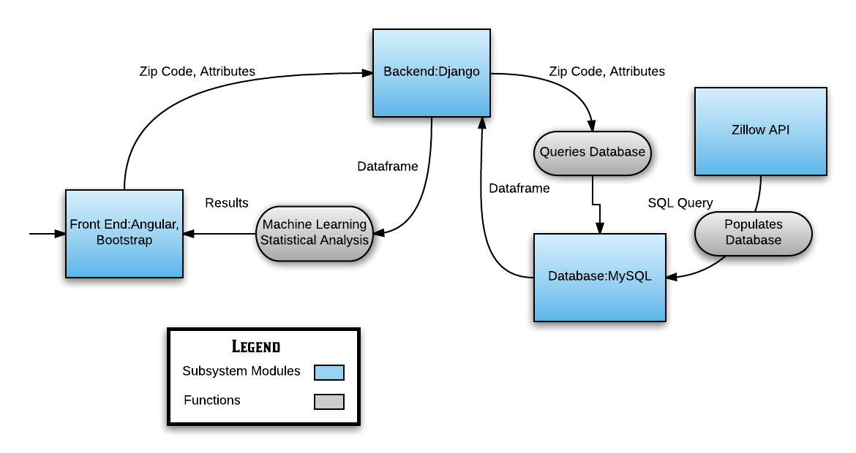
System Model

Slide 11
Front End Subsystem
Goal of the Front End Subsystem:
Fulfill the needs set forth in the Functional, User Interface, and Usability Requirements
Developed using JavaScript and HTML/CSS through the frameworks AngularJS v.1.3.14 and Bootstrap v.3.3.7
Single Page Web Application
Fulfills requirement that any part of the application can be reached within 2-3 clicks
Lends to a simple user interface

Slide 12
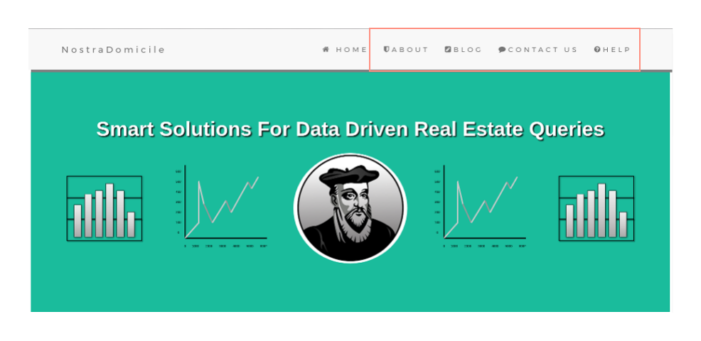

Slide 13
Front End Subsystem
Fulfills functional requirements that the application has About, Expert Blog, Contact Us, and Help Sections
Makes use of Angular Routing to ensure that NostraDomicile.com is a single page application, with no need for page reloads
Navigation Bar

Slide 14
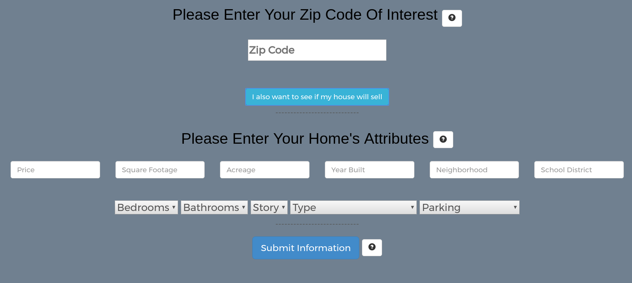

Slide 15
Front End Subsystem
User Interface and Usability Requirements are satisfied by creating text input areas, drop down boxes and submit buttons follow the same design
For longer load times a loading wheel has been created
User Input

Slide 16
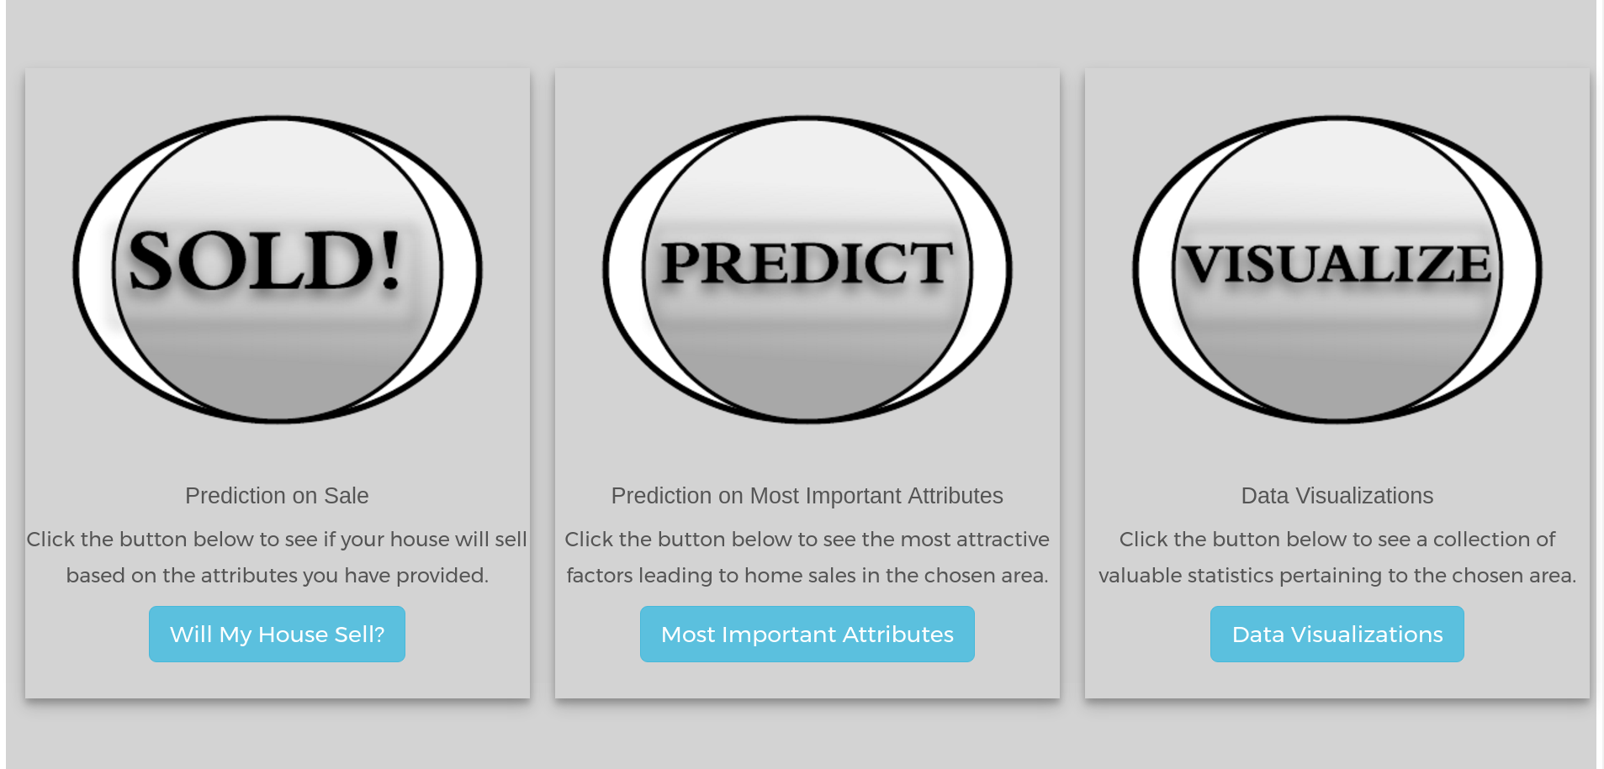

Slide 17
Front End Subsystem
Satisfies the Functional Requirements:
Users able to input attributes and location for predictive home sale analysis
Users able to view data visualizations for housing data based on zip code
Users able to view most influential factors in home sales for a given area
Results displayed in pop-up modals which continue the adherence to Single Page Web Application
Function Cards

Slide 18
Back End Subsystem
Programming language: Python
Web Framework: Django
Web Server: Apache
Host: AWS
Description: The Django backend will also be broken into many different functions, but it will follow a MVC format. Functions such as making calls to the Zillow API, querying the database, sending data to the frontend to be displayed, etc.

Slide 19
Database Subsystem
MySQL Database - data stored in relational DB. Includes, among other things:
Zipcode
Status (sold/unsold)
Home attributes (floor type, parking, etc.)
Data from Zillow (via PyZillow API).
Ideally, data would be directly from MLS database- constantly updated and more complete.

Slide 20
Machine Learning Subsystem
Machine Learning with Random Forest.
Binary classifications on categorical features is more straightforward
Generates an ensemble of decision trees and uses the majority classification of those trees to determine result
implemented using Scikit-learn library in Python
K-fold Cross validation
Tasks
Generates a trained random forest model from the data from surrounding homes
Makes predictions on whether a user’s house will sell based on the features of the home
Generate a list of features

Slide 21
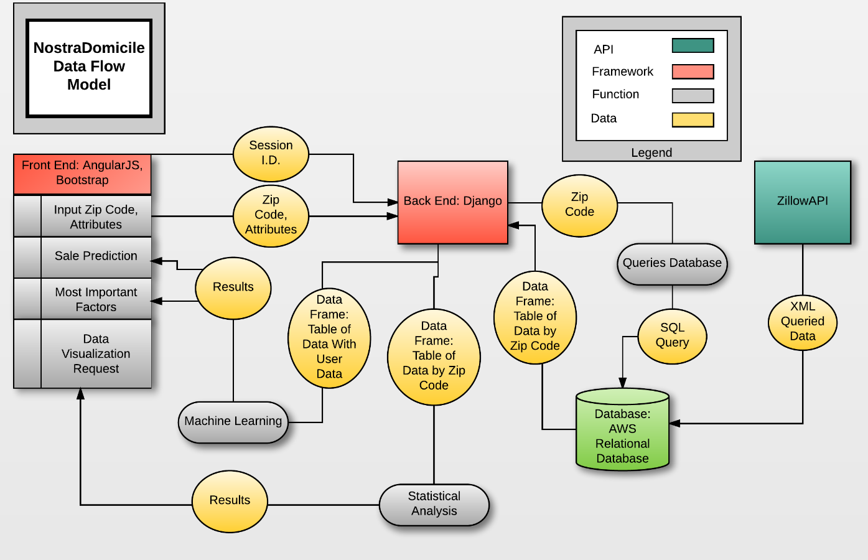

Slide 22
Demonstration

Slide 23
Future Efforts
Finish data visualization submodule
Invite realtors to submit posts to the blog
Adjust the front-end for mobile phone browsers
Add support for more classifiers
Support Vector Machine
Deep Belief Network
Implement a login system

Slide 24
References
Breiman, Leo. "Random Forests." Machine Learning 45.1 (2001): 5-32. Print.
A Study of Cross-Validation and Bootstrap for Accuracy Estimation and Model Selection. Ijcai. 1995. Stanford, CA. Print.
Data Structures for Statistical Computing in Python. Proceedings of the 9th Python in Science Conference. 2010. van der Voort S, Millman J. Print.
Pedregosa, Fabian, et al. "Scikit-Learn: Machine Learning in Python." Journal of Machine Learning Research 12.Oct (2011): 2825-30. Print.
Walt, Stéfan van der, S Chris Colbert, and Gael Varoquaux. "The Numpy Array: A Structure for Efficient Numerical Computation." Computing in Science & Engineering 13.2 (2011): 22-30. Print.

Slide 25
The End
Thanks!

Slide 26
Architecture decisions: AngularJS & Bootstrap vs. Pure HTML/CSS
AngularJS & Bootstrap
Pro: It uses MVC, so it’s more organized.
Pro: It’s easier to manipulate DOM.
Pro: Write less code.
Pro: Consistency and responsive.
Con: Experience.
Con: Have to include the dependencies of both frameworks.
Pure HTML/CSS
Pro: Can write/code only what you need, instead of strictly following MVC.
Pro: None, or not as many, dependencies.
Con: Not as consistent or responsive.
Con: Harder to manipulate DOM.

Slide 27
Architecture decisions: Ruby on Rails VS Django
Django
Pro: Since machine learning will be in Python, simplifies code by reducing the number of languages used.
Pro:Easily implemented database connectors.
Con: No experience with this framework.
Ruby on Rails
Pro: Some experience with this framework.
Pro:
Con: More difficult to coordinate with machine learning b/c of language differences
Con: Native Machine learning requires different libraries for different modules

Slide 28
Approach
Problem:
It can be difficult to determine whether a house will sell and what factors will influence its desirability in a particular area.
Solution:
Project Goal: Create a web application which determines if a house will sell based on desirable factors in an area and allows users to explore houses on the market based on their preferences and desired location.
Project Description: NostraDomicile will accomplish this goal by:
Retrieving and storing housing market information using a Zillow API and MySQL database
Using machine learning to evaluate housing data and determine factors influencing home sales in a particular area
Creating a user-friendly interface for users to view data about factors influencing home sales and create data visualizations about houses on the market based on user preferences

Slide 29
Hosting decision: Cloud Hosting vs Local Hosting
Cloud
Pro: 24/7 access.
Pro: Hardware requirements handled by external party.
Pro: Easier to scale.
Pro: Has support if we run into problems.
Con: Costs money.
Con: Requires internet access.
Localhost
Pro: More control.
Pro: Free.
Pro: More security.
Con: Hardware requirements must be met by group members.
Con Local hardware failure could create issues.

Slide 30
Database decision: MySQL VS MongoDB
MySQL
Pro: Several members of our group have experience with MySQL.
Pro: Data integrity constraints enforced.
Pro: “Transaction” processes supported natively.
Con: Not easily scalable - requires horizontal partitioning or clustering.
Con: Requires explicit data type declarations and data must conform.
Con: High transaction loads seriously affect performance.
MongoDB
Pro: Doesn’t rely on object relational mapping - more flexibility.
Pro: All object info is stored in a single instance accessed via key - simple.
Pro: More scalable than relational DB.
Con: No enforcement for data integrity constraints.
Con: No join operation comparable to SQL relational JOIN.
Con: No experience with NoSQL databases.

Slide 31
Roles and Responsibilities
Frontend: Jeremy Hutton
Backend: Richard Andrews
Backend/Database: Christian Simaan
Frontend/Machine Learning: Ochaun Marshall
Note: When any member finishes work in their role, they will help with another role where needed and/or appropriate.

Slide 32
Project Progress
Developed Data Acquisition Program and Started Acquisition
Using Python with PyZillow
Set Up AWS Services
Elastic Beanstalk, Relational Database, Server Instance
Developed MySQL and Python Function For Database Creation
Created MySQL RD Instance on AWS Server
Started Parameterizing Random Forest Based on Attributes From PyZillow
Developed Front End Design
Began Developing Front End

Slide 33
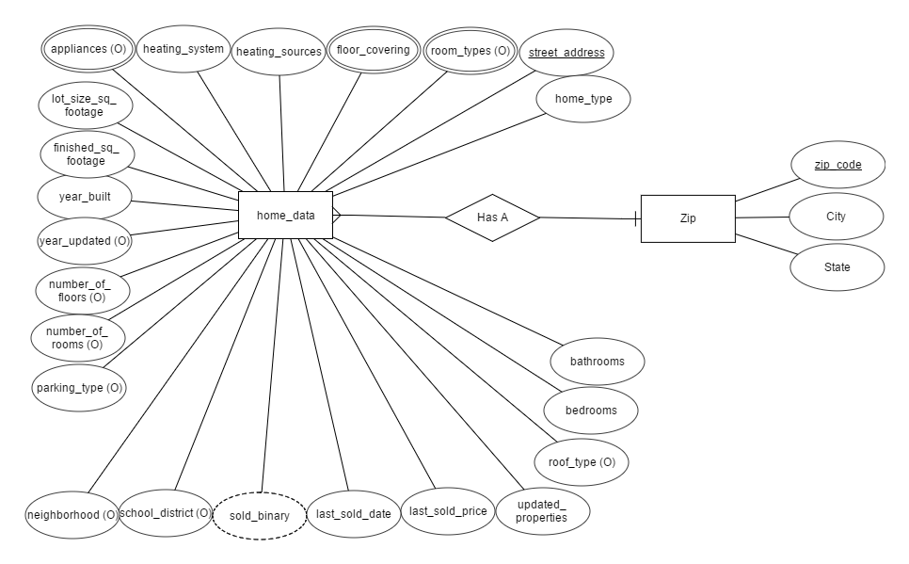
Entity-Relationship Model

Slide 34
Data Dictionary
Home data from Zillow API stored in database table home_data in PyZillow_Data schema. Includes:
Home attributes, for example, address (PK), zip code (secondary index attribute), last sale date, last sale price, and number of bed/bath rooms.
Values showing additional details were available and if a house “sold” for use in sale predictions.
Data from user sessions:
Session ID
Attribute filters for sale predictions and data visualizations.

Slide 35
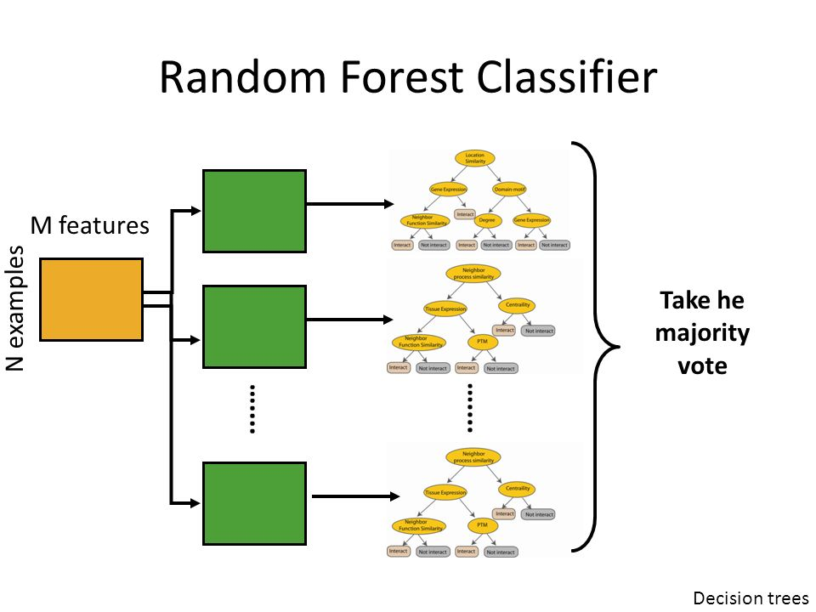
Vladimir Vapnik

Slide 36
Algorithm Analysis(Random Forest)
Random Forest Algorithm:
Supervised learning as opposed to online learning
Built with a multitude of Decision Trees
Bootstrap sampling
Averaging tree results to reach a predicted classification
Time and Space Complexity of Algorithm:
Time: O(M(mn log n)) Space: O(mn log n)
Where M=number of trees, m=number of features, and n=number of elements in the dataset.
---Vens, Costa, Random Forest Based Feature Induction, Data Mining, 2011

Slide 37
Algorithm Analysis(Database Functions)
Uses a b+-tree index on primary key “address”, ln(n) to search. ¹
Insertions
Time: Lookup to avoid error from existing PK (ln(n)) + API call (constant “C”) + insertion into DB(ln(n) + C) = 2(ln(n) + C) = O(ln(n)).
Space: Only current index node keys are stored in memory (say, “m” keys per node) + record for insertion (C) = m +C = O(m).
Lookup:
Time: For a single record, index search (ln(n)) + transfer to memory (C) = ln(n) + C = O(ln(n)). For multiple records, still O(ln(n)) since C*(ln(n)) = O(ln(n)).
Space: Current index keys (m) + PK of record sought (1) = m +1 = O(m).
¹ Silberschatz,Abraham,et al. Database Systems Concepts,6th Ed. p. 490.

Slide 38
Algorithm Analysis(System)
Time Complexity of Database Query: O(log n)
Time Complexity of Random Forest: O(M(mn log n))
O(M(mn log n)) + O(log n)
Random Forest Dominates
Time Complexity of System: O(M(mn log n))

Slide 39
Approach towards coding
Work individually on our separate subsystems.
Connect our subsystems once progress has been made.
Prevents any subsystem from halting the entire system.

Slide 40
Frameworks and Languages
Python 2.7.4
Django 1.9.2
JavaScript
AngularJS 1.3.14
HTML/CSS
Bootstrap 3.3.7
MySQL 5.6.27

Slide 41
Member Roles
Front-end: Jeremy
Example tasks: UI and site coding, creating assets for site (Jeremy also assists with database population).
Back-end: Richard
Example tasks: Server setup and deployment, backend processing (outside of machine learning).
Database: Christian
Example tasks: Database setup and population (Christian also assists with back-end setup, deployment, etc).
Machine Learning: Ochaun
Example tasks: Machine learning algorithm setup.

Slide 42
Completion status of code
Role | Members | Task | Status
Front-End | Jeremy | Displaying static files and basic ui on the server. | Completed
Front-End | Jeremy, Richard | Submit form data to the back end for machine learning analyzing. | In Progress
Front-End | Jeremy | Finish content for about section, blog section. | In Progress
Front-End | Jeremy | Finish charts for visualizations. | In Progress

Slide 43
Completion status of code
Role | Members | Task | Status
Front-End | Jeremy | Get email on contact section working. | In Progress
Back-End | Richard, Christian | Establish server connection to the database. | Completed
Back-End | Richard, Christian, Jeremy | Display static files on the server for the front-end to access. | Completed
Back-End | Richard, Jeremy, Christian | Take forms from the front end, and process them with the machine learning. | In Progress

Slide 44
Completion status of code
Role | Members | Task | Status
Database | Christian, Jeremy | Data acquisition. | Completed
Database | Jeremy | Create unit tests. | In Progress
Machine Learning | Ochaun | Algorithm setup. | In Progress
Machine Learning | Ochaun, Richard | Help install machine learning setup on server. | In Progress

Slide 45
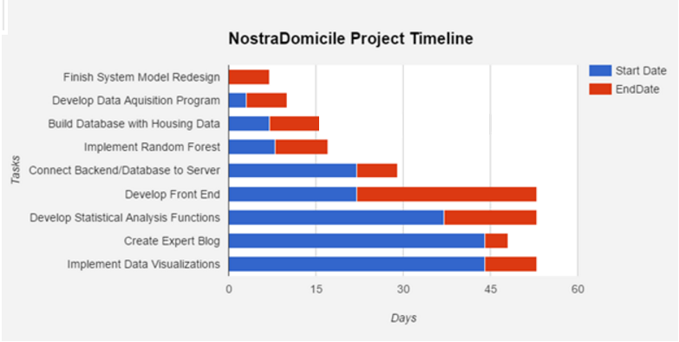
Old Timeline

Slide 46
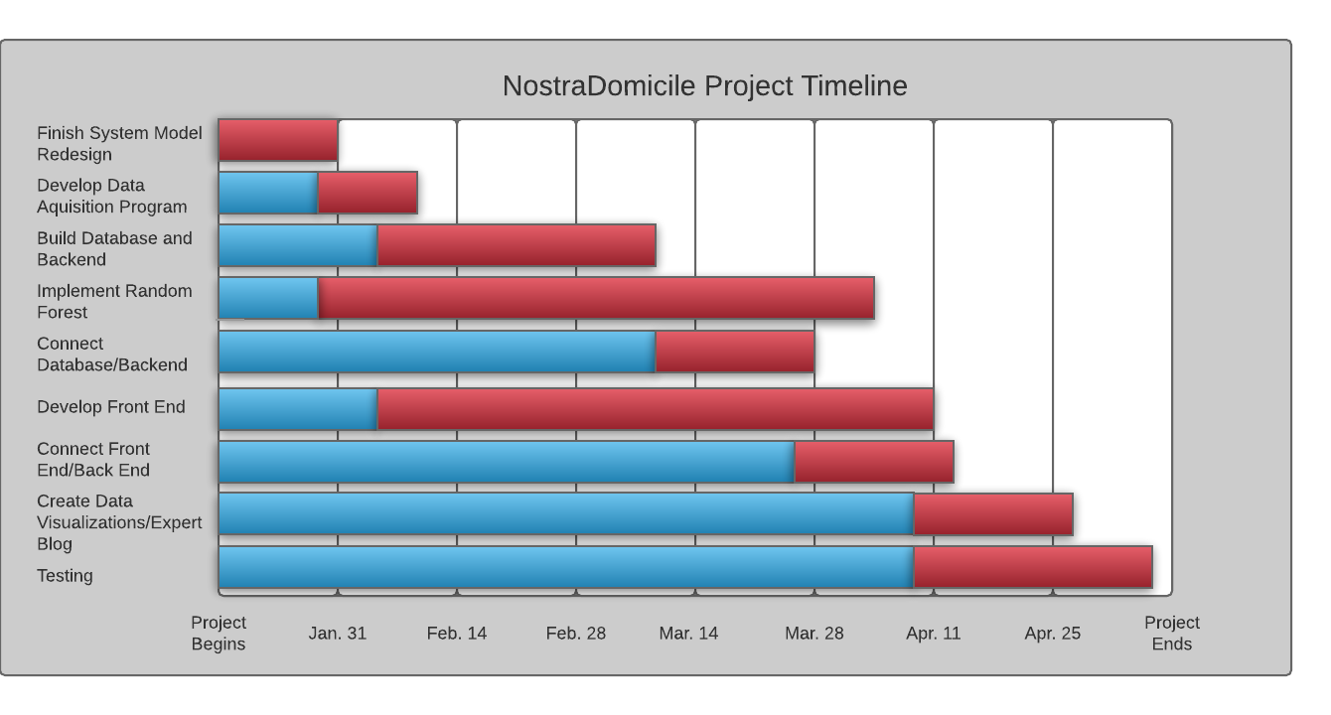
New Timeline

Slide 47
Sub-modules and their coding methods
The next several slides will describe the coding methods used in each subsystem’s submodules. Each subsystem will also describe any unit tests that will be used.

Slide 48
Submodule - Front End
Navigation Bar: Uses Angular routing to create section within single page web application.
About Section: Uses Bootstrap text panel to describe goal of application
Blog Section: Will route to specific blog entry(text panel) from list of blog entries in the section
Contact Us Section: Uses Bootstrap Form to create Email form

Slide 49
Submodule-Front End (cont.)
User Input: Section of the Web Application that takes in information from user necessary to perform major functions.
Text input areas and drop down selection boxes that are created using Bootstrap. Capture of input variables made possible through Angular controllers.
Bootstrap popover modules installed in order to provide user with information regarding the use of their information.
HTML formatting employed to make Input Area aesthetically pleasing.

Slide 50
Submodule-Front End (cont.)
Web Application Main Functions: Through the use of Bootstrap cards, main functions are separated clearly.
Bootstrap modals are used to display the results of selecting one of the web application’s functions.
A binary will sell/won’t sell will be displayed in the modal for “Will My House Sell?” through a call to the Random Forest algorithm.
A list of factors will be displayed in the modal for “Most Important Attributes through a call to the Random Forest algorithm.
Charts displayed using either Plotly, Echarts or ChartsJS to display “Data Visualizations” through a call to the database.

Slide 51
Submodule Testing - Front End
Unit tests for:
Each path is valid.
Input text areas take correct input with valid length.
Dropdown boxes display correct choices and can be clicked.
Submission buttons work as expected.
Sales prediction model displays correct message.
Most important factors display correctly.

Slide 52
Submodule Testing - Front End (cont.)
Data visualizations displayed correctly with appropriate responsiveness.
About page displays correct information.
Contact page displays correctly and can send emails.
Expert blog page displays correctly.
Web application displays in similar fashion on all browsers.
Web application responsiveness works on web and mobile platforms.

Slide 53
Submodule - Back End
Coding methods:
MVC model for layout
Templates for views
Limited public access (only what’s required to display for front end)
Models for database accessing and security/backup
Error logging

Slide 54
Submodule Testing - Back End
Static files are being displayed:
Can access the static files through URLs.
Can access the static files through AngularJS.
Server can connect to the database:
Can make a connection to the database.
Can query the database and get correct results.
Server is sanitizing user input before querying the database.

Slide 55
Submodule - Database
Coding methods:
Normalization
Indexing

Slide 56
Submodule Testing - Database
Insertions - Database is verifying requirements for new records:
Non-null attributes are not null - Test by submitting records with null values for non-null attributes.
Attributes within accepted range of values - Test by submitting records with values outside of range of accepted values.
Query Results - Attributes are configured to return correct query results.
Records have attribute specified by query - Test by submitting queries with ranges of values for different attributes and check results to see if results match queries.
Verify that queries generated by frontend calls return appropriate results - Test by submitting various input to front end and see if results match query requests.

Slide 57
Requirements
Training
Single Page Application
Navigation Bar Follows General Web Conventions
Contact Page Includes an Email Form Linked to NostraDomicile@gmail.com
About Page
Expert Blog Page
Contact Page

Slide 58
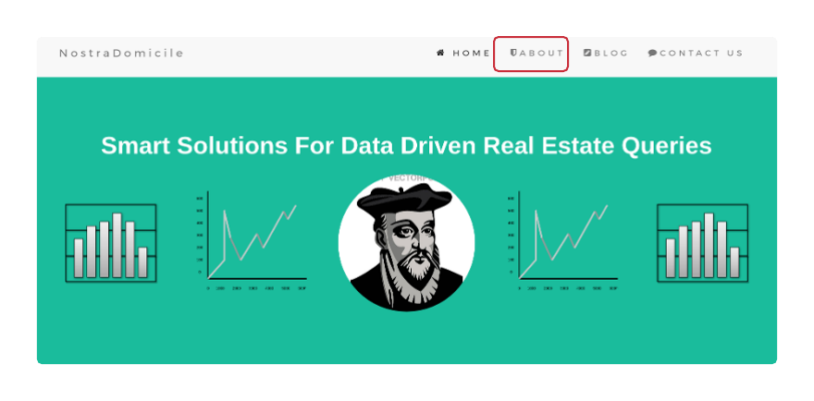

Slide 59
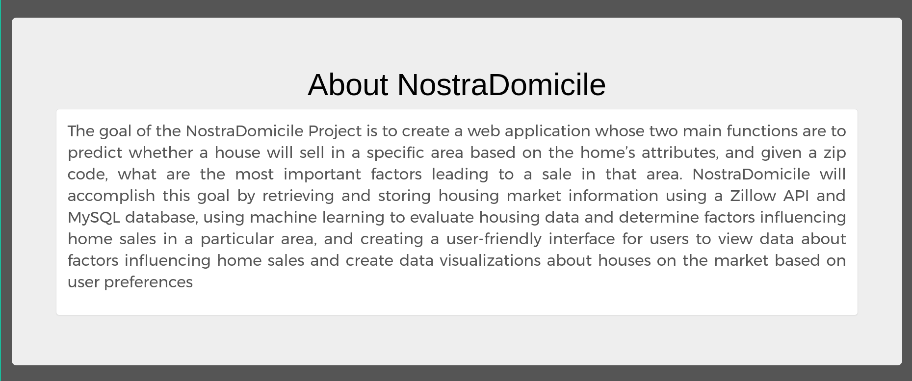

Slide 60
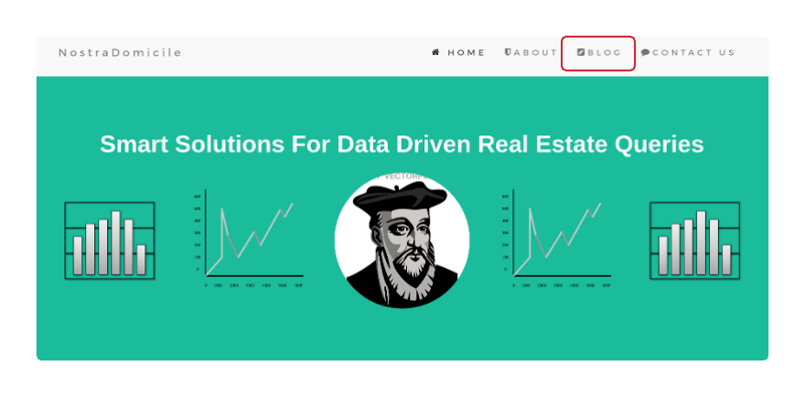

Slide 61
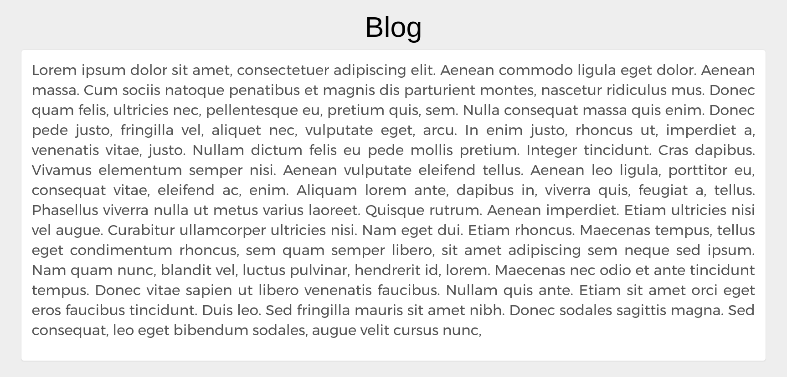

Slide 62
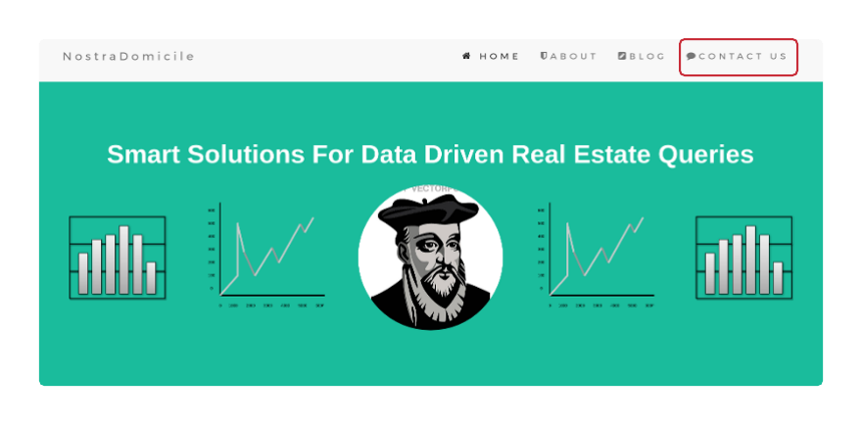

Slide 63
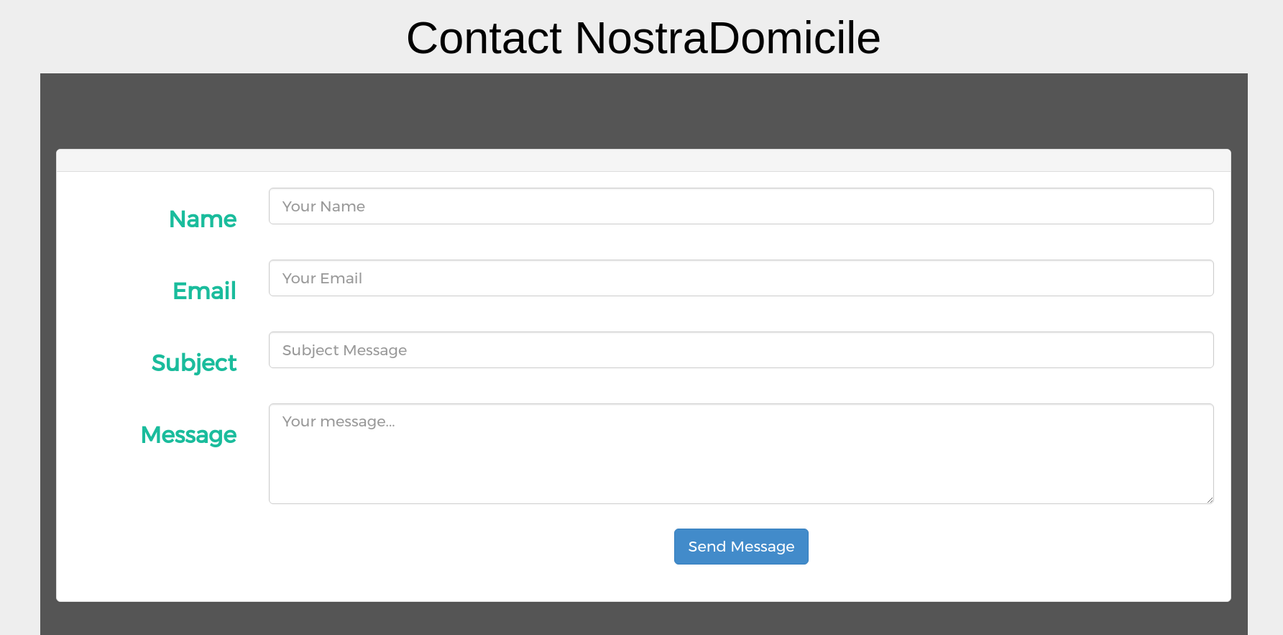

Slide 64
Requirements
Training
Zip Code Input
Text Areas And Dropdown Boxes For User To Input Home Data
Submit Information Button
Zip Code Input is used for all three of the site’s main functions
Zip Code Input used alone in return of most important factors
Zip Code Input and Home’s Attributes are used in the “Will Your House Sell?” function
Zip Code Input used to return statistics on user’s area of interest
The Submit Button, when pressed, captures all user information

Slide 65
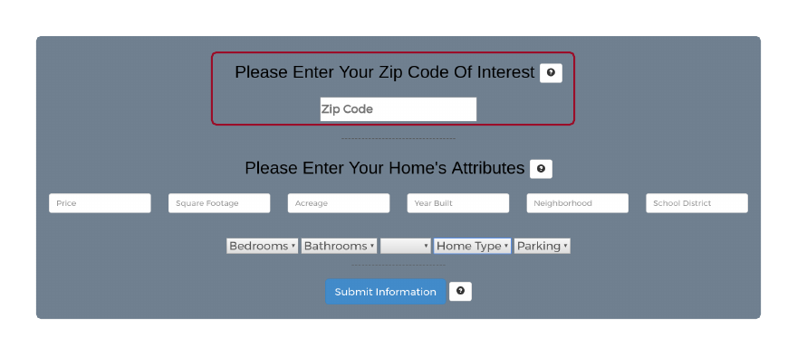

Slide 66
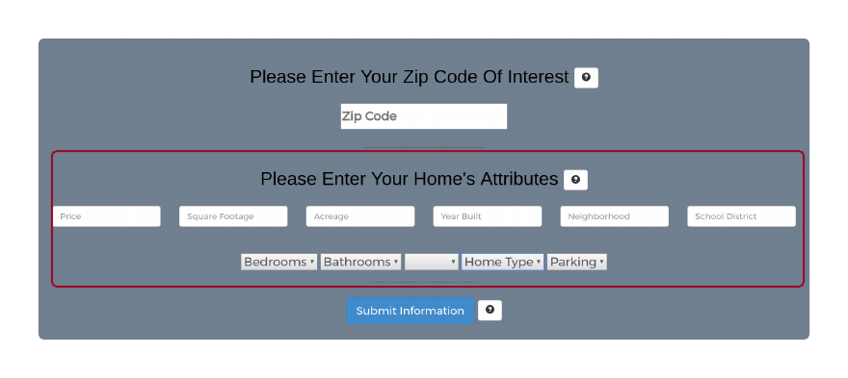

Slide 67
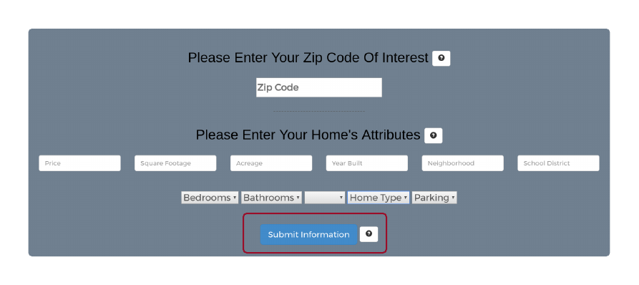

Slide 68
Requirements
Training
Sale Prediction Function
Most Important Attributes Function
Data Visualization Function
When “Will Your House Sell?” button pressed an in-window message box appears with a will/will not sell answer
When the “Most Important Attributes” button is pressed an in-window message appears with a histogram of most important attributes
When “Data Visualizations” button is pressed, a suite of charts and graphs appear based on the target zip code.

Slide 69
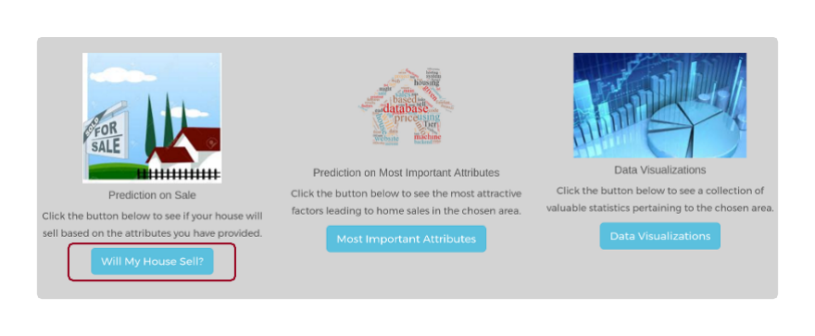

Slide 70
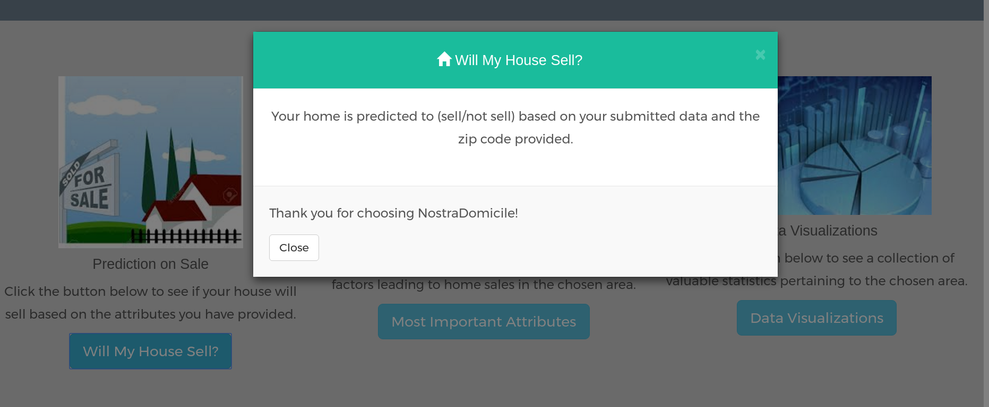

Slide 71


Slide 72
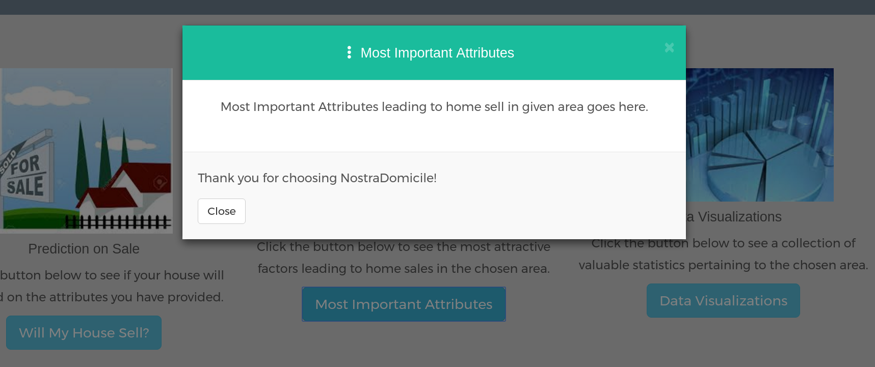

Slide 73


Slide 74
